Slide 1
Dynamic Parallel Programming
Cole Berkley, Zihao Hong, Jiaju Wang, Aarya Atluri

Slide 2
Introduction
Dynamic programming is a method for solving complex problems by breaking them into different subproblems, finding the optimal solution for each of them, and combining all optimal solutions to get the final result.
LLP(lattice-linear predicate) is a powerful approach to formalizing parallel methods in solving sequential problems by constantly updating solution vectors given the forbidden predicates.
Four algorithms we implement: Longest Increasing Subsequence, Optimal Binary Search Tree, Matrix Multiplication, Knapsack

Slide 3
Longest Increasing Subsequence
To find the longest increasing subsequence, we
created an array G which stores the length of the longest increasing subsequence at each index i, and a flag array called fixed.
For each thread, compare and find the max of indexes j where the array value index j represents is less than i. Store that max+1 into G[i], but in order to keep the order persistent, every time you compare, check and make sure that are j all fixed , if not, we should discard current process. Set the current G fixed at the end of the process.
returns G as the longest increasing subsequence.
The parallel example, {35,38,27,45,32}, I get the following table for my implementation.
Parallel Runtime complexity for this is going to be O(klogN) where k is the length of the longest sequence, N is the length of the input array since each thread only checks for those to the left of G[j].

Slide 4
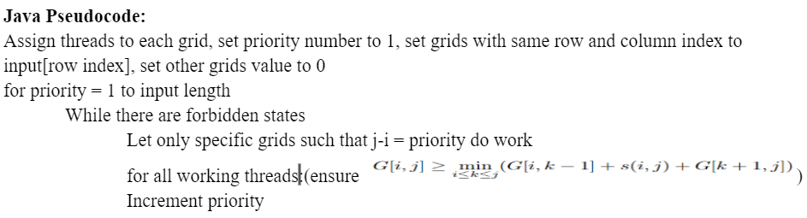
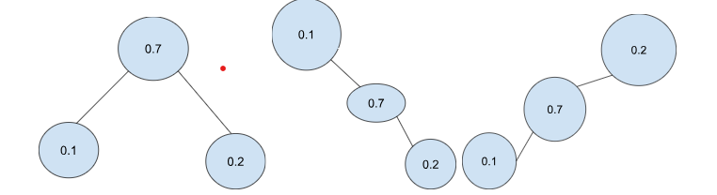

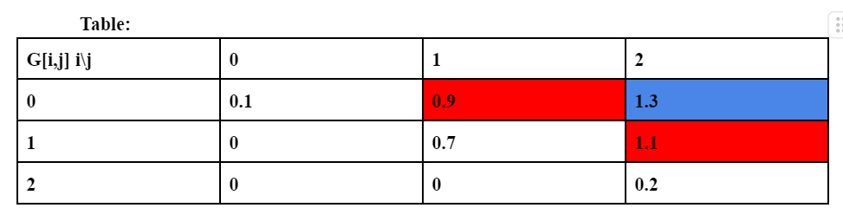
Optimal Binary Search Tree
Predicate:
Runtime: O(n log n) for parallel and O(n^3) for sequential

Slide 5
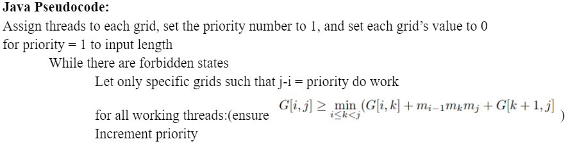
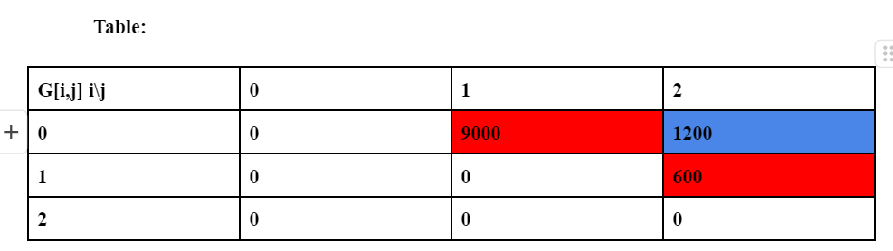
Matrix Multiplication
M1(30*10), M2(10*30), M3(30*2)
Predicate:
Runtime: O(n log n) for parallel and O(n^3) for sequential

Slide 6
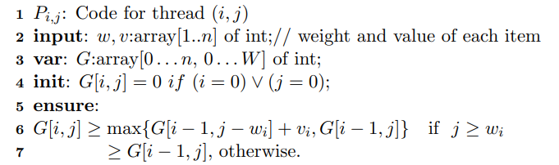
Knapsack
Combinatorial Optimization Problem
Sequential Solution: O(nW) time
Parallel Solution: O(n) time (with W cores)
“Select subset of items with given weights and values to maximize total value without exceeding weight limit”
Predicate: G[i, j] ≥ max(G[i - 1, j - w_{i} ] + v_{i} , G[i - 1, j]) for all i, w > 0 and w_{i} ≤ j.
State Table: Pseudocode:
G[i, j] | 0 | 1 | 2 | 3 | 4 | 5 | 6 | 7
1, 1 | 0 | 1 | 1 | 1 | 1 | 1 | 1 | 1
4, 3 | 0 | 1 | 1 | 4 | 5 | 5 | 5 | 5
5, 4 | 0 | 1 | 1 | 4 | 5 | 6 | 6 | 9
7, 5 | 0 | 1 | 1 | 4 | 5 | 7 | 8 | 9

Slide 7
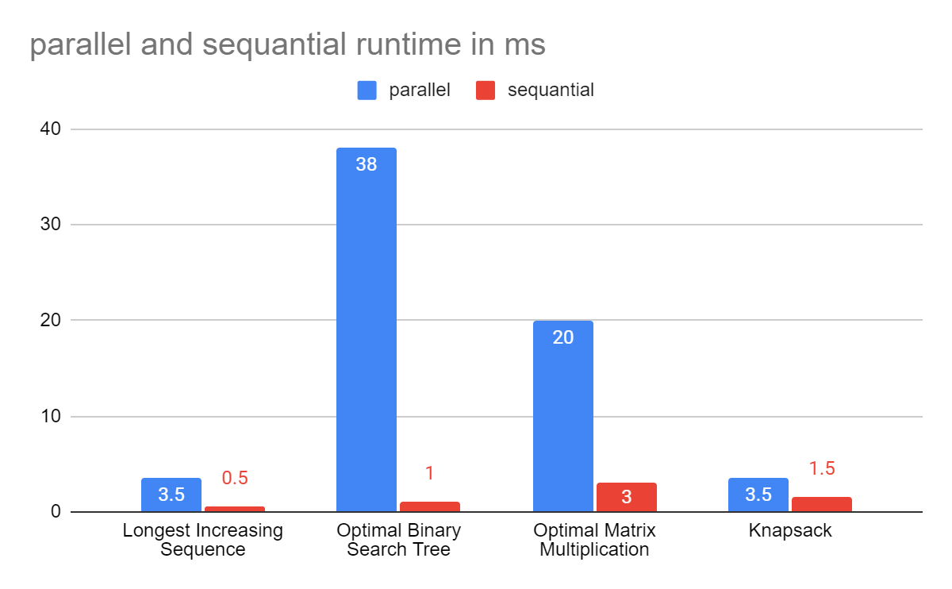
Runtime Comparison

Slide 8
Thank you for viewing!

